Slide 1
主要内容
多项式归约： A ≤_{P}B
归约举例
库克定理
李荣洋
D202110397
计算机科学与技术

Slide 2




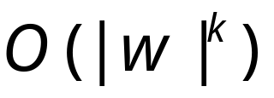
Polynomial Time Reductions
Polynomial Computable function :
There is a deterministic Turing machine
such that for any string computes
in polynomial time:

Slide 3
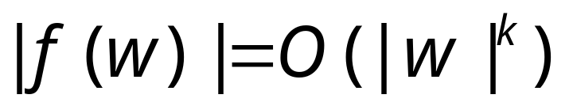

Observation:
since, cannot use
more than tape space
in time

Slide 4


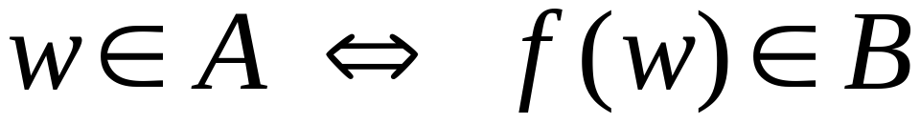
Definition:
Language
is polynomial time reducible to
language
if there is a polynomial computable
function such that:

Slide 5





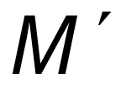
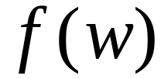
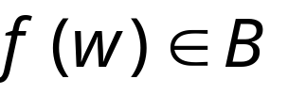

Theorem:
Suppose that is polynomial reducible to .
If then .
Proof:
Let be the machine that decides
in polynomial time
Machine to decide in polynomial time:
On input string :
1. Compute
2. Run on input
3. If acccept

Slide 6
归约举例
多项式时间归约：如果问题X和问题Y满足以下两条性质，那么问题X可以在多项式时间归约到问题Y。
  - 问题X可以通过多项式时间的基本运算步骤转换为问题Y；
  - 问题X多项式次调用求解问题Y的算法，且问题Y可以在多项式时间内被求解。
可以记为：X ≤p Y。
理解：
  问题Y比问题X的时间复杂度更高，问题X不难于B。
  问题Y比问题X的使用范围更广。
  NP问题都可归约到NPC问题。

Slide 7
NP problems
1
2
1
2
1
2
3
4
3
4
3
4
clique
independent set
vertex cover
CLIQUE = {〈G, k〉: G is a graph with a clique of k vertices}
IS = {〈G, k〉: G is a graph with an independent set of k vertices}
VC = {〈G, k〉: G is a graph with a vertex cover of k vertices}

Slide 8
SAT and 3SAT
SAT = {〈φ〉: φ is a satisfiable Boolean formula}
((x₁∨x₂ ) ∧ (x₁∨x₂)) ∨ ((x₁∨(x₂ ∧ x₃)) ∧ x₃)
3SAT = {〈φ〉: φ is a satisfiable 3CNF formula}
(x₁∨x₂∨x₂ ) ∧ (x₂∨x₃∨x₄) ∧ (x₂∨x₃∨x₅) ∧ (x₁∨x₅∨x₅)

Slide 9
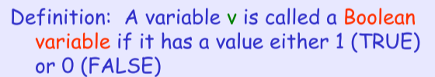
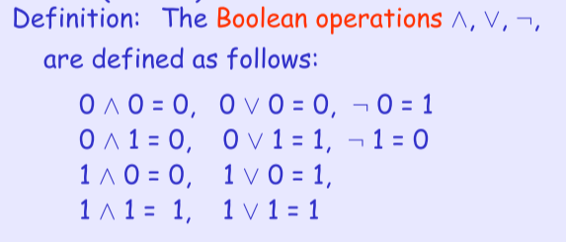
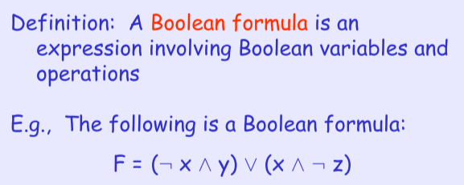
SAT and 3SAT

Slide 10
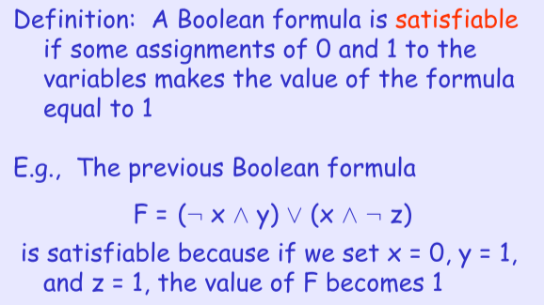
SAT and 3SAT

Slide 11
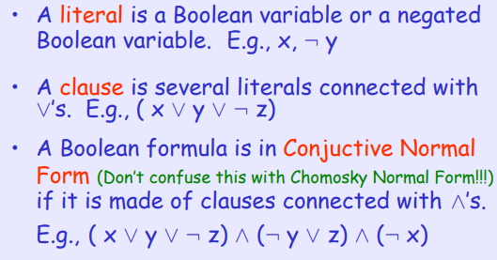
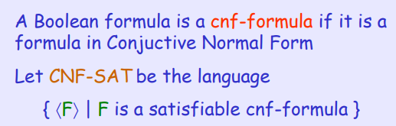
CNF-合取范式（与操作）

Slide 12
归约
归约证明步骤：
  归约构造。
  正确性证明，证明构造过程的正确性。
  复杂性证明，验证总的时间复杂度是否是多项式级复杂度。
    1. O(1),O(log(n)),O(n^a)-----多项式级复杂度（n出现在底数位置）。
    2. O(a^n)和O(n!)----非多项式级复杂度，复杂度计算机往往无法承受。

Slide 13
Polynomial-time reductions （CLIQUE≤_{P} IS）
IS = {〈G, k〉: G is a graph with an independent set
of k vertices}
CLIQUE = {〈G, k〉: G is a graph with a clique of k vertices}
Theorem
1
2
If IS has a
polynomial-time TM,
so does CLIQUE
3
4
{1, 4}, {2, 3, 4} are
independent sets
{1, 2}, {1, 3} are cliques

Slide 14
Polynomial-time reductions
If IS has a polynomial-time TM, so does CLIQUE
Proof: Suppose IS has an poly-time TM A
We want to use it to solve CLIQUE
accept
if G has clique of size k
accept
if G’ has IS of size k
〈G, k〉
A
_{for IS}
〈G’, k’ 〉
reject
if not
reject
if not

Slide 15
Reducing CLIQUE to IS
We look for a polynomial-time TM R that turns the question:
into:
“Does G have a clique of size k?”
R
G, k
G’, k’
“Does G’ have an IS of size k’?”
1
2
1
2
flip all edges
G
G’
3
4
3
4
k’ = k
cliques of size k
ISs of size k’

Slide 16
Reducing CLIQUE to IS
On input 〈G, k〉
Construct G’ by flipping all edges of G
Set k’ = k
Output 〈G’, k’〉
R
G, k
G’, k’
cliques in G
independent sets in G’
If G’ has an IS of size k,
then G has a clique of size k
✓
If G’ does not have an IS of size k,
then G has no clique of size k
✓

Slide 17
Reducing IS to VC
Proof: We describe a reduction from IS to VC
Example
(G, k)
R
(G’, k’)
G has an IS of size k
G’ has a VC of size k’
vertex covers
independent sets
1
2
{2, 4}, {3, 4},
{1, 2, 3}, {1, 2, 4},
{1, 3, 4}, {2, 3, 4},
{1, 2, 3, 4}
∅, {1}, {2}, {3}, {4},
{1, 2}, {1, 3}
3
4

Slide 18
Reducing IS to VC
Claim
Proof
1
2
S is an independent set of G if and
only if S is a vertex cover of G
3
4
IS
VC
S is an independent set of G
∅
{1}
{2}
{3}
{4}
{1, 2}
{1, 3}
{2, 4}
{3, 4}
{1, 2, 3}
{1, 2, 4}
{1, 3, 4}
{2, 3, 4}
{1, 2, 3, 4}
no edge has both endpoints in S
every edge has an endpoint in S
S is a vertex cover of G

Slide 19
Reducing IS to VC
R
VC
(G, k)
(G’, k’)
✓
IS
✓
CLIQUE
R:
On input (G, k),
Output (G, n – k).
3SAT
SAT
G has an IS of size k
G has a VC of size n – k

Slide 20
Example of a polynomial-time reduction:
We will reduce the
3CNF-satisfiability problem
to the
CLIQUE problem

Slide 21
3CNF formula:
literal
clause
Each clause has three literals
Language:
3CNF-SAT ={ : is a satisfiable
3CNF formula}

Slide 22



A 5-clique in graph
Language:
CLIQUE = { : graph
contains a -clique}

Slide 23
Theorem:
3CNF-SAT is polynomial time
reducible to CLIQUE
Proof:
give a polynomial time reduction
of one problem to the other
Transform formula to graph

Slide 24










Transform formula to graph.
Example:
Clause 2
Create Nodes:
Clause 3
Clause 1
Clause 4

Slide 25


Add link from a literal to a literal in every
other clause, except the complement

Slide 26
Resulting Graph

Slide 27
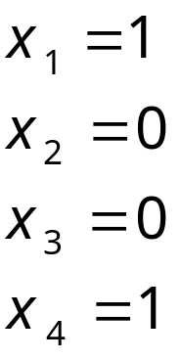
The formula is satisfied if and only if
the Graph has a 4-clique
End of Proof

Slide 28
Reducing 3SAT to CLIQUE
3CNF formula f
R
(G, k)
R:
On input f, where f is a 3CNF formula with m clauses
Construct the following graph G:
G has 3m vertices, divided into m groups,
one for each literal in f
If a and b are in different groups and a ≠ b,
put an edge (a, b)
Output (G, m)

Slide 29
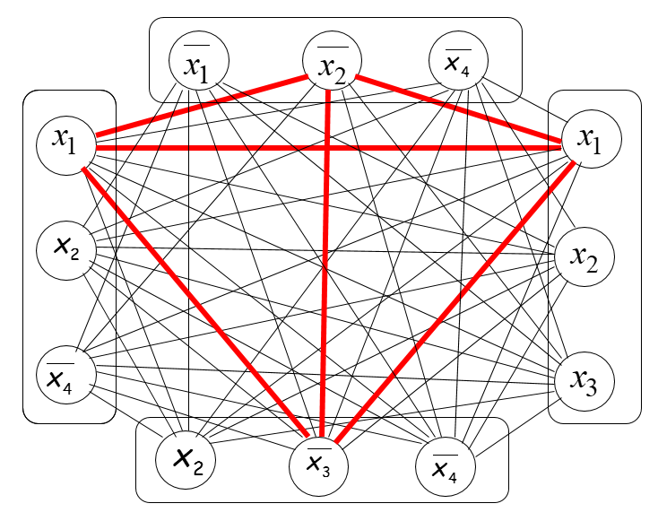
Reducing 3SAT to CLIQUE
3CNF formula f
R
(G, m)
f is satisfiable
G has a clique
of size m
φ = (x₁∨x₂∨x₄ ) ∧ (x₁∨x₂∨x₄) ∧ (x₁∨x₂∨x₃) ∧ (x₂∨x₃∨x₄)
T
F
F
F
T
F
T
F
F
F
T
F

Slide 30
Reducing 3SAT to CLIQUE
3CNF formula f
R
(G, m)
f is satisfiable
G has a clique
of size m
φ = (x₁∨x₂∨x₄ ) ∧ (x₁∨x₂∨x₄) ∧ (x₁∨x₂∨x₃) ∧ (x₂∨x₃∨x₄)
T
F
F
F
T
F
T
F
F
F
T
F

Slide 31
Reducing 3SAT to CLIQUE
3CNF formula f
R
(G, m)
f is satisfiable
G has a clique
of size m
VC
✓
Every satisfying assignment of f gives
a clique of size m in G
Conversely, every clique of size m in G
gives a consistent satisfying assignment of f.
IS
✓
CLIQUE
✓
✓
3SAT
SAT

Slide 32
SAT and 3SAT
SAT = {〈φ〉: φ is a satisfiable Boolean formula}
((x₁∨x₂ ) ∧ (x₁∨x₂)) ∨ ((x₁∨(x₂ ∧ x₃)) ∧ x₃)
3SAT = {〈φ〉: φ is a satisfiable 3CNF formula}
(x₁∨x₂∨x₂ ) ∧ (x₂∨x₃∨x₄) ∧ (x₂∨x₃∨x₅) ∧ (x₁∨x₅∨x₅)

Slide 33
Reducing SAT to 3SAT
Example: φ =
(x₂∨(x₁∧x₂ ))∧(x₁∧(x₁∨x₂ ))
x₁₀
x₄ x₅ x₇
x₇ = x₄ ∧ x₅
AND
T T T T
T T F F
T F T F
T F F T
F T T F
F T F T
F F T F
F F F T
x₈
x₉
(x₄∨x₅∨x₇)
(x₄∨x₅∨x₇)
OR
NOT
x₆
x₇
(x₄∨x₅∨x₇)
AND
AND
(x₄∨x₅∨x₇)
x₃
x₄
x₅
NOT
NOT
OR
(x₄∨x₅∨x₇)
x₂
x₁
x₂
x₁
x₁
x₂
∧(x₄∨x₅∨x₇)
∧(x₄∨x₅∨x₇)
∧(x₄∨x₅∨x₇)
We add extra variables for every “wire”

Slide 34
Turning gates into 3CNFs
z
z
z
G_{j}:
AND
OR
NOT
x
y
x
y
x
x
y
z
z = y ∧ x
x
y
z
z = y ∨ x
x
z
z = x
T T T T
T T F F
T F T F
T F F T
F T T F
F T F T
F F T F
F F F T
T T T T
T T F F
T F T T
T F F F
F T T T
F T F F
F F T F
F F F T
T T F
T F T
F T T
F F F
(x∨z)∧(x∨z)
(x∨y∨z)∧(x∨y∨z)
∧(x∨y∨z)∧(x∨y∨z)
(x∨y∨z)∧(x∨y∨z)
∧(x∨y∨z)∧(x∨y∨z)
φ_{j}:
(x∨x∨z)∧(x∨x∨z)

Slide 35
Reducing SAT to 3SAT
Boolean formula φ
R
3CNF formula φ’
R:=
On input φ, where φ is a boolean formula
Construct and output the following 3CNF formula φ’:
φ’ has extra variables x_{n+1,} ..., x_{n+t}
one for each gate G_{j} in φ
For each gate G_{j}, construct the formula f_{j}
Output
φ’ = φ_{n+1} ∧ φ_{n+2} ∧ ... ∧ φ_{t} ∧ (x_{n+t} ∨x_{n+t} ∨x_{n+t} )
requires that
output of f is true

Slide 36
Reducing SAT to 3SAT
Boolean formula φ
R
3CNF formula φ’
φ is satisfiable
✔
φ’ is satisfiable
Every satisfying assignment of φ extends uniquely to a satisfying assignment of φ’
In the other direction, in every satisfying assignment of φ’ the part x₁, ..., x_{n} is satisfies φ

Slide 37
Equivalence of certain NP languages
We strongly suspect that problems like CLIQUE, SAT, etc. require time ≈2^{n} to solve
We do not know how to prove this, but what we can prove is that
If any one of them can be solved efficiently,
then all of them can be solved efficiently

Slide 38
Cook-Levin Theorem

Slide 39
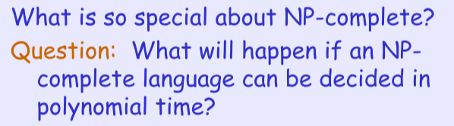
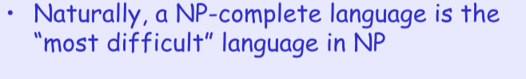


NP-completeness
A language C is NP-complete if:
1. C is in NP, and
2. For every L in NP, L reduces to C.
C
NP
P

Slide 40
The Cook-Levin Theorem
SAT = {φ: φ is a satisfiable Boolean formula}
E.g.
(x₁∨x₂ ) ∧ (x₂ ∨x₃ ∨x₄) ∧ (x₁)
Theorem： SAT is P if and only if P=NP
Theorem： SAT is NP-complete
  So every problem in NP is no harder than
  SAT, SAT must be the “hardest problem”
  in NP:
If SAT ∈ P, then P = NP
Every L ∈ NP reduces to SAT
SAT
NP
P

Slide 41
Interpretation of Cook-Levin Theorem
Optimistic view:
Pessimistic view:
If we manage to solve SAT, then we can also solve
CLIQUE and many other things
Since we do not believe P = NP, it is unlikely that
we will ever have a fast algorithm for SAT

Slide 42
NP-completeness
IS
reduces to
VC
CLIQUE
3SAT
Cook-Levin theorem:
SAT
NP-complete
Everything in NP
reduces to SAT
NP
P
(easy to verify solution)
(easy to solve)

Slide 43
Proof of Cook-Levin
Cook-Levin Theorem:
Language SAT (satisfiability problem)
is NP-complete
Proof:
Part1:
SAT is in NP
(we have proven this in previous class)
Part2: reduce all NP languages
to the SAT problem
in polynomial time

Slide 44
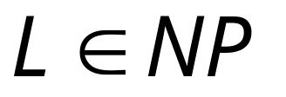

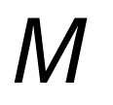
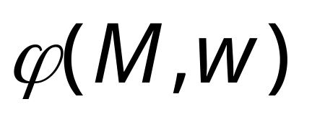
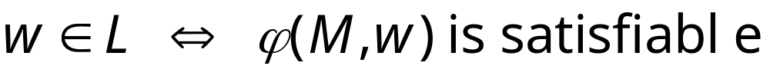
Take an arbitrary language
We will give a polynomial reduction of to SAT
Let be the NonDeterministic
Turing Machine that decides in polyn. time
For any string we will construct
in polynomial time a Boolean expression
such that:

Slide 45




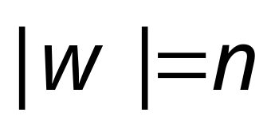
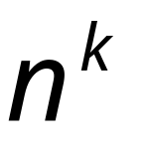
All computations
of on string
depth
…
…
…
…
accept
reject
accept
(deepest leaf)
reject

Slide 46
Consider
an accepting
computation
depth
…
…
…
…
accept
reject
accept
(deepest leaf)
reject

Slide 47

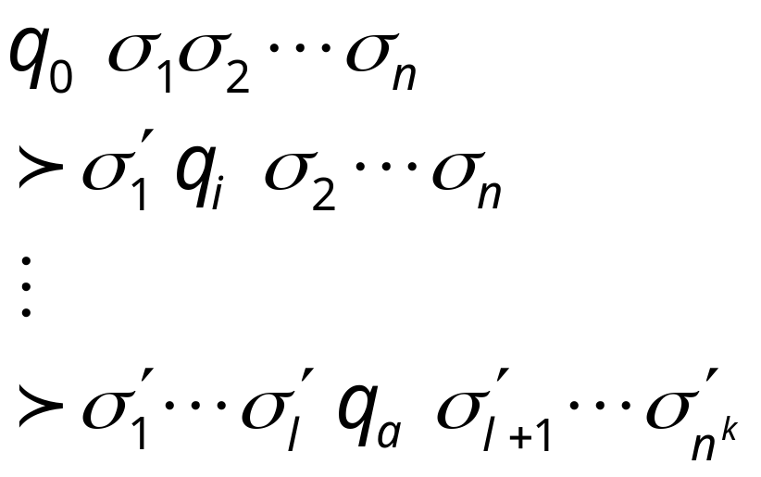




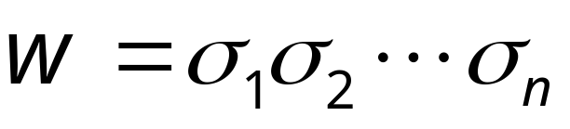
Computation path
Sequence of
Configurations
initial state
…
accept state
accept

Slide 48




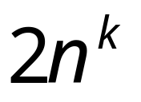
Machine Tape
Maximum working space area on tape
during time steps

Slide 49
















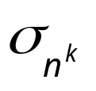


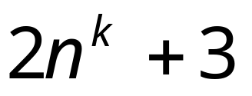
Tableau of Configurations
……
Accept configuration
indentical rows

Slide 50
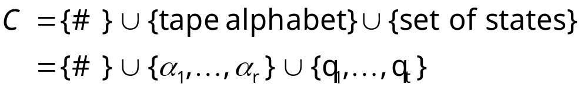
Tableau Alphabet
Finite size (constant)

Slide 51
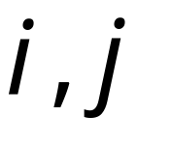
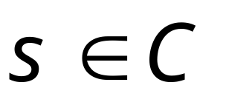
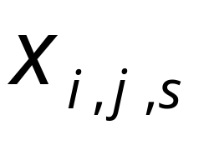

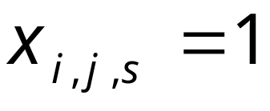
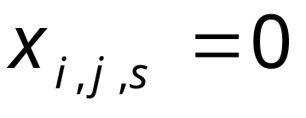
For every cell position
and
for every symbol in tableau alphabet
Define variable
Such that if cell contains symbol
Then
Else

Slide 52

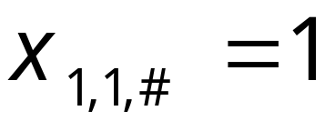
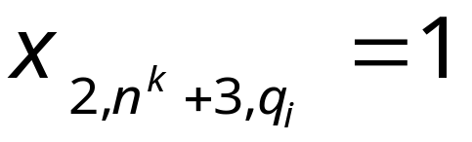
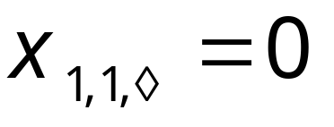
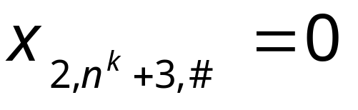
Examples:

Slide 53


is built from variables
When the formula is satisfied,
it describes an accepting computation
in the tableau
of machine on input

Slide 54


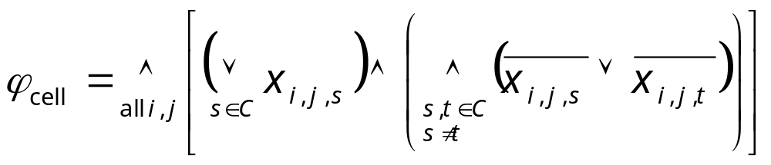
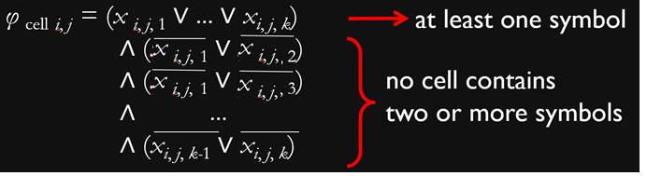
每个单元恰好包含一个符号
φ_{cell} = φ _{cell} _{1, 1} ∧ ... ∧ φ _{cell} _{2nk+3,} _{2nk+3}
Every cell contains
at least one symbol
Every cell contains
at most one symbol

Slide 55
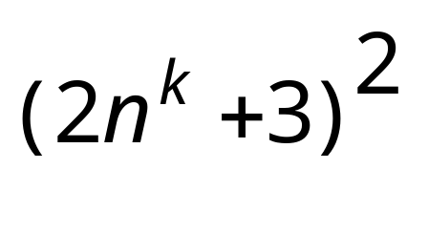



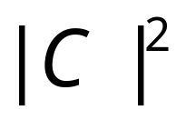


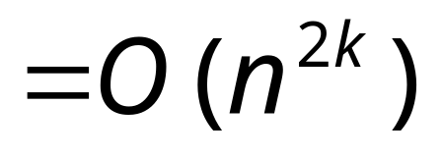
Size of :

Slide 56

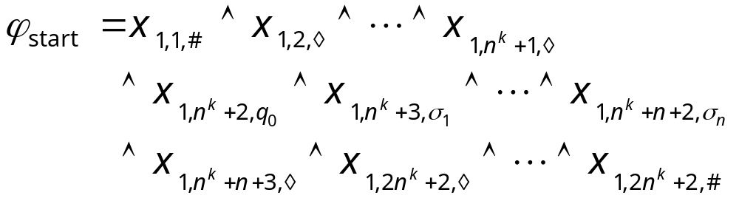
第一行是初始格局
Describes the initial configuration
in row 1 of tableau

Slide 57
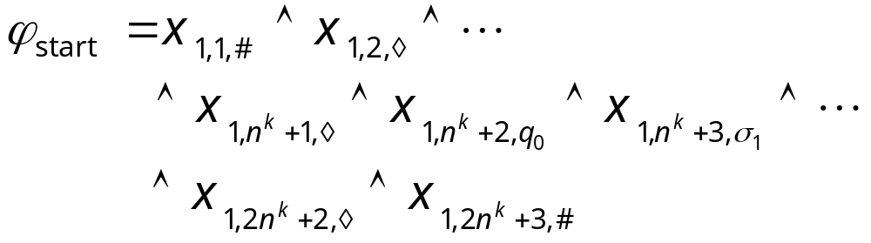
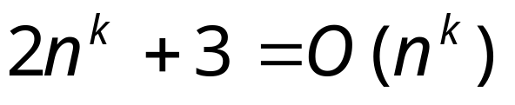
Size of :

Slide 58

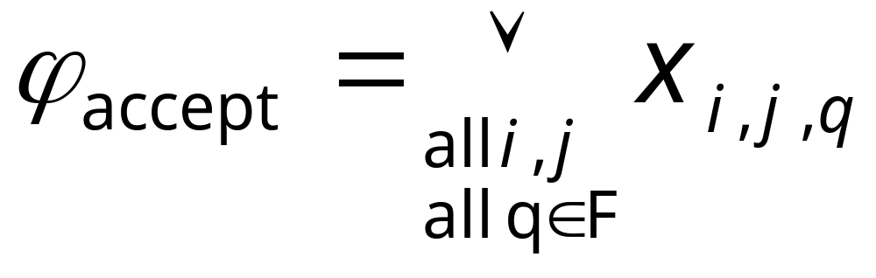
某一行是接受格局
Accepting states
An accept state should appear somewhere
in the tableau

Slide 59
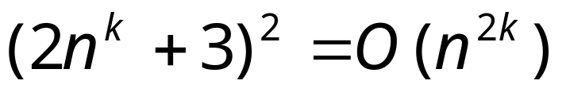
Size of :

Slide 60

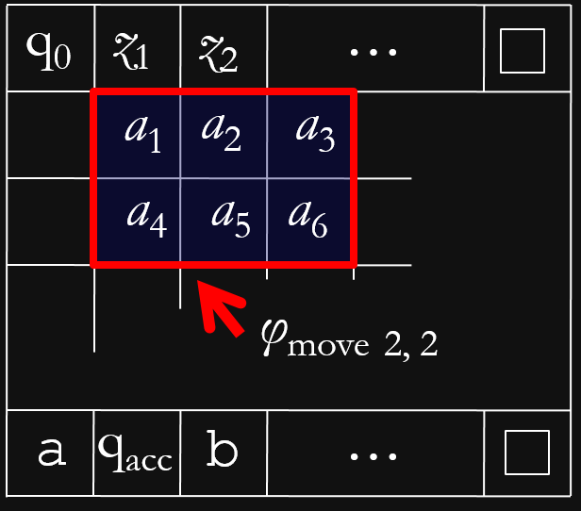
下一行都是上一行的合法后续格局
is expressed in terms of
legal windows
The moves between rows follow transitions

Slide 61





Tableau
Window
2x6 area of cells

Slide 62



Possible Legal windows
Legal windows obey the transitions

Slide 63
Possible illegal windows

Slide 64
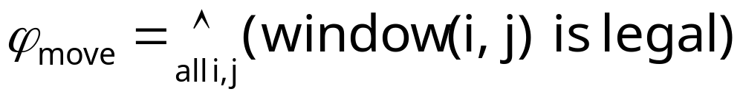




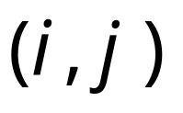
window (i,j) is legal:
((is legal)
(is legal)
(is legal))
all possible legal windows
in position

Slide 65

(is legal)
Formula:
+2

Slide 66






Size of :
Size of formula for a legal window
in a cell i,j:
Number of possible legal windows
in a cell i,j:
at most
Number of possible cells:

Slide 67




Size of :
it can also be constructed in time
polynomial in

Slide 68
we have that:

Slide 69

Since,
and
is constructed
in polynomial time
is polynomial-time reducible to SAT
END OF PROOF

Slide 70
Observation 1:
The formula can be converted
to CNF (conjunctive normal form) formula
in polynomial time
Already CNF
NOT CNF
But can be converted to CNF
using distributive laws

Slide 71


Distributive Laws:

Slide 72

Observation 2:
The formula can also
be converted to a 3CNF formula
in polynomial time
convert

Slide 73
From Observations 1 and 2:
CNF-SAT and
3CNF-SAT are
NP-complete languages
(they are known NP languages)

Slide 74



Theorem:
If: a. Language is NP-complete
b. Language is in NP
c. is polynomial time reducible to
Then: is NP-complete
Proof:
Any language in NP
is polynomial time reducible to .
Thus, is polynomial time reducible to
(sum of two polynomial reductions,
gives a polynomial reduction)

Slide 75
Reduction recap
We showed that
by converting an imaginary TM for IS into one for CLIQUE
To do this, we came up with a reduction that transforms instances of CLIQUE into ones of IS
If IS has a polynomial-time TM, so does CLIQUE

Slide 76
小结：Polynomial-time reductions
Language L polynomial-time reduces to L’ if
there exists a polynomial-time TM R that takes an instance x of L into instance y of L’ s.t.
x ∈ L if and only if y ∈ L’
L
(CLIQUE)
L’
(IS)
= 〈G, k〉
R
x
y
= 〈G’, k’〉
x ∈ L
y ∈ L’
(G has clique of size k)
(G’ has IS of size k’)

Slide 77
The meaning of reductions
Saying L reduces to L’ means L is no harder than L’
  In other words, if we can solve L’, then we can also solve L
Therefore
If L reduces to L’ and L’ ∈ P, then L ∈ P
R
poly-time TM for L’
acc
x
y
rej
x ∈ L
y ∈ L’
TM accepts

Slide 78
Polynomial-time reductions
What do we mean when we say, for example,
We mean that
Or,
“IS is at least as hard as CLIQUE”
If CLIQUE has no polynomial-time TM, then
neither does IS
If IS has polynomial-time TM, then
so does CLIQUE

Slide 79
The direction of reductions
The direction of the reduction is very important
  Saying “A is easier than B” and “B is easier than A” mean different things
However, it is possible that L reduces to L’ and L’ reduces to L
  This means that L and L’ are as hard as one another
  For example, IS and CLIQUE reduce to one another
Notes:
往后放。

